Slide 1
AVIATION ACCIDENT DATABASE SUMMARY
END DATE :27TH JUNE 2025
BEGIN DATE: 24TH JUNE 2025

Slide 2
INTRODUCTION.
Project goal: To identify which aircraft models and types have the lowest operational risk to guide safe and cost-effective entry into the aviation market.
Importance: This enable the new head of aviation to make decisions straight-forward for the success of the company when joining the aviation market.

Slide 3
DATA OVERVIEW.
Source of data: Aviation Accident Database & Synopses, up to 2023.
Size of data: The data has 88889 records and 31 features.
Main features: The main features were those that could answer questions like ;
The types of aircrafts we had
Number of incidents within each aircraft type
Were the incidents fatal, serious, minor or no occurrence
what caused the incident and etc.

Slide 4
DATA CLEANING AND PREPROCESSING.
Missing data: Most of the missing values in features, were filled with unknown placeholders to avoid biasness. A few were dropped and rest filled with values from other relating features.
Duplicated values: They were none.
Outliers check: The outliers were identified but not dropped.

Slide 5

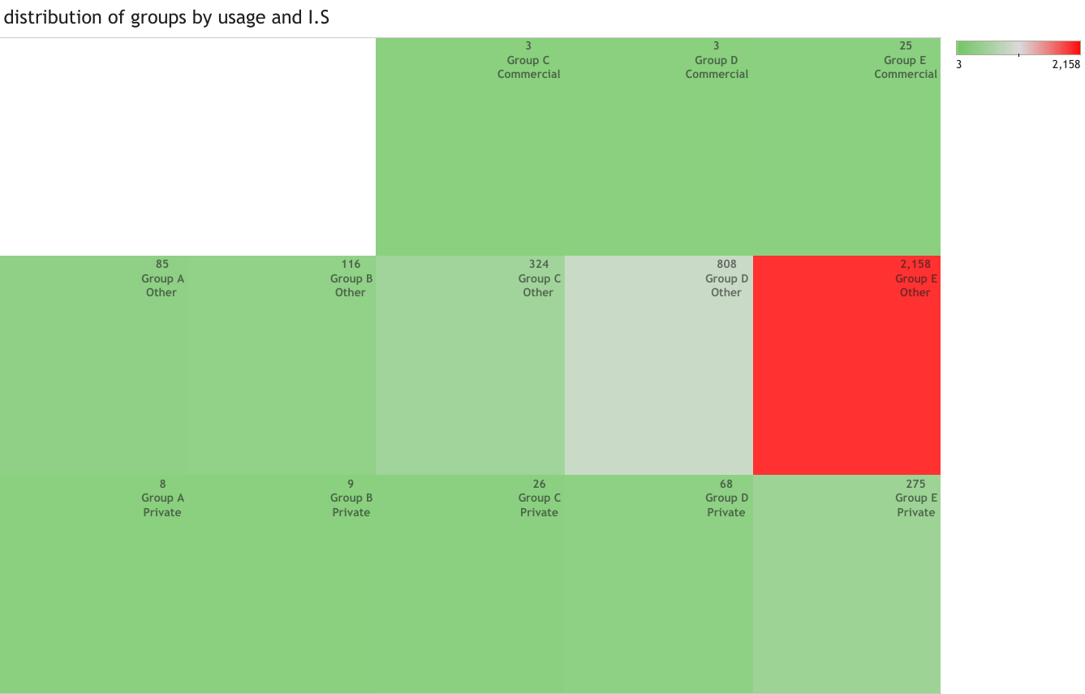
KEY FINDINGS.
In summary, group A and B models have no injury incidents on commercial category.
Commercial category along all groups C to E have less occurrence of injuries.
The Other type of usage has high incidences and are of high injury severity.
The private category has high injury severity too.

Slide 6
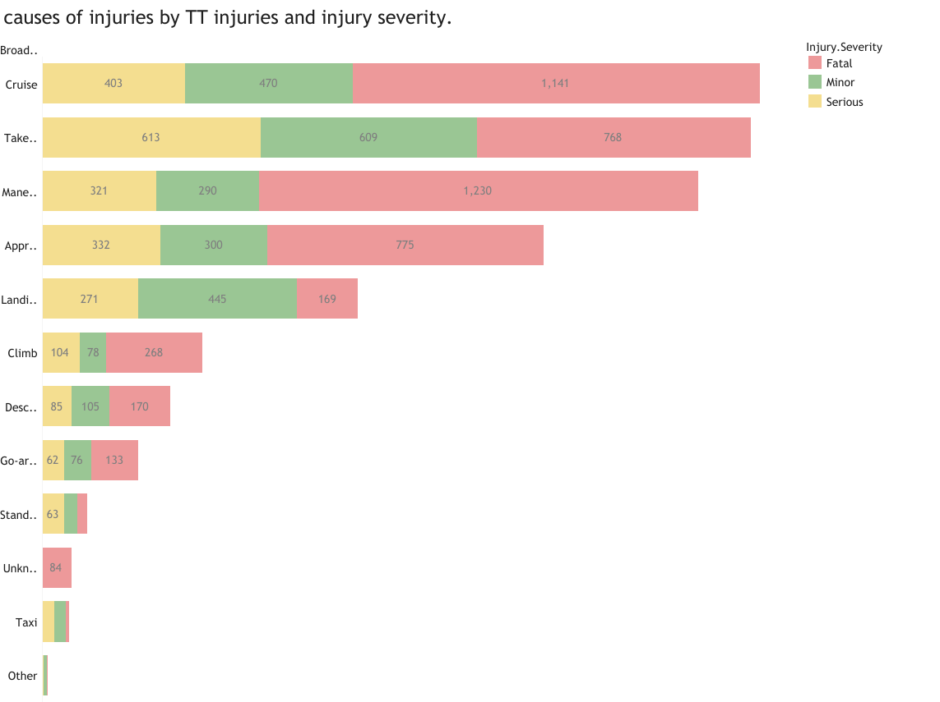
This chart answers the question:
What phase do accidents occurs most?
On the Cruise phase , maneuvering and take off phase have high injury severity. The accidents are fatal and serious.
However, the landing phase has the highest incidence occurrence but there not sever.

Slide 7
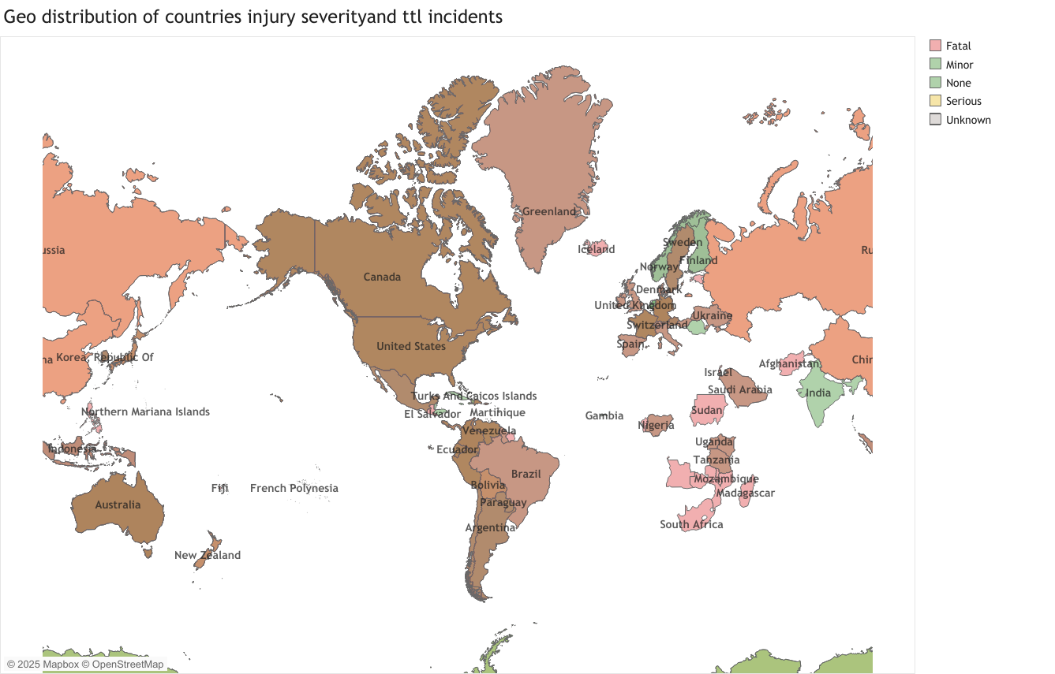
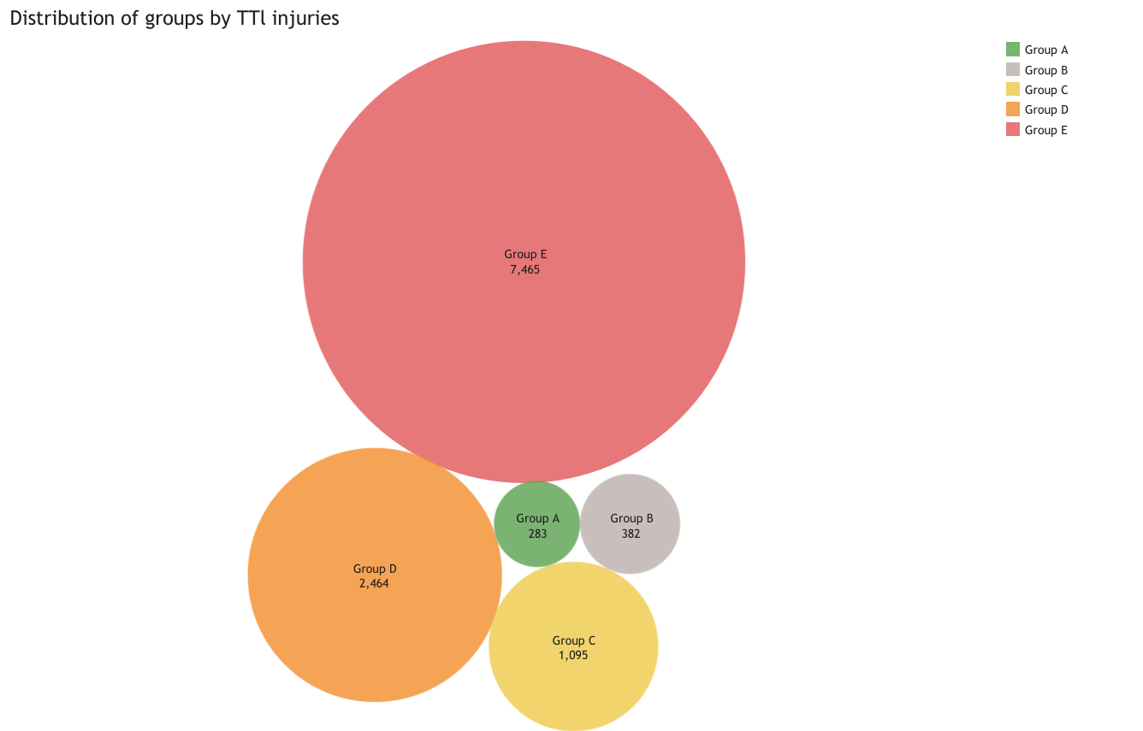
The map chart shows the countries with high severity and ones with low severity.
India ,Finland and Norway countries are among those with low or no incidence of injuries.
Russia, Canada and US are among countries with high severity injuries.
Red shows fatal injuries while green shows no or minor injuries.
The packed bubbles show the distribution of injury severity by the model groups.
The group A and B models with low injury severity thus can be safe for implementation.
The Group E shows Models with high severity hence the company can choose not to use them.

Slide 8
RECOMMENDATIONS.
The company should consider doing Commercial or general Aviation since they show low injury severity than the private and other usage types.
The company can use the Group A and B models for the have operational efficiency.
On phases:
Prioritize engine performance monitoring and crew readiness training for rapid decision-making during takeoff roll.
Use predictive maintenance and real-time system monitoring to detect anomalies early.
Hire well trained pilots to avoid incidences that may cause company bankrupt Ness.
Conduct further feature engineering for further understanding of the data.

Slide 9
CONCLUSION.
Q And A
THANK YOU FOR YOUR PATIENCE .
By:
Muriithi Zipporah.

